Slide 1
• PROGRAM OF “PHYSICS”
Lecturer: Dr. DO Xuan Hoi
Room 413
E-mail : dxhoi@hcmiu.edu.vn

Slide 2
PHYSICS 4
(Wave and Modern Physics)
02 credits (30 periods)
Chapter 1 Mechanical Wave
Chapter 2 Properties of Light
Chapter 3 Introduction to Quantum Physics
Chapter 4 Atomic Physics
Chapter 5 Relativity and Nuclear Physics

Slide 3
References :
Halliday D., Resnick R. and Walker, J. (2005), Fundamentals of Physics, Extended seventh edition. John Willey and Sons, Inc.
Alonso M. and Finn E.J. (1992). Physics, Addison-Wesley Publishing Company
Hecht, E. (2000). Physics. Calculus, Second Edition. Brooks/Cole.
Faughn/Serway (2006), Serway’s College Physics, Brooks/Cole.
Roger Muncaster (1994), A-Level Physics, Stanley Thornes.

Slide 4
http://ocw.mit.edu/OcwWeb/Physics/index.htm
http://www.opensourcephysics.org/index.html
http://hyperphysics.phy-astr.gsu.edu/hbase/HFrame.html
http://www.practicalphysics.org/go/Default.html
http://www.msm.cam.ac.uk/
http://www.iop.org/index.html
.
.
.

Slide 5
PHYSICS 4
Chapter 3 Introduction
to Quantum Physics
The Wave Property of Electrons
De Broglie’s Theory - Matter Wave
The Schrödinger’s Equation
The Heisenberg’s uncertainty principle
Particle in a square well
Tunneling Phenomena

Slide 6
Nature of light
Diffraction, Interference phenomena → light has wave nature
Photoelectric, Compton’s effects → light has particle nature
What is the nature of light?
ANSWER:
From a modern viewpoint,
the light has both wave and particle characteristics
That is
The Wave-Particle Duality of Light
“… the wave and corpuscular descriptions are only to be
regarded as complementary ways of viewing one and the same
objective process…” (Pauli, physicist)

Slide 7
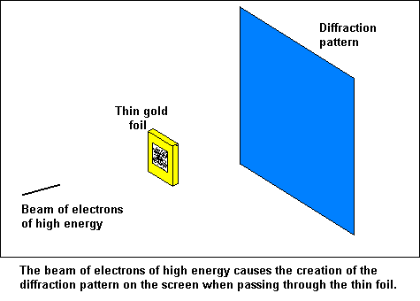
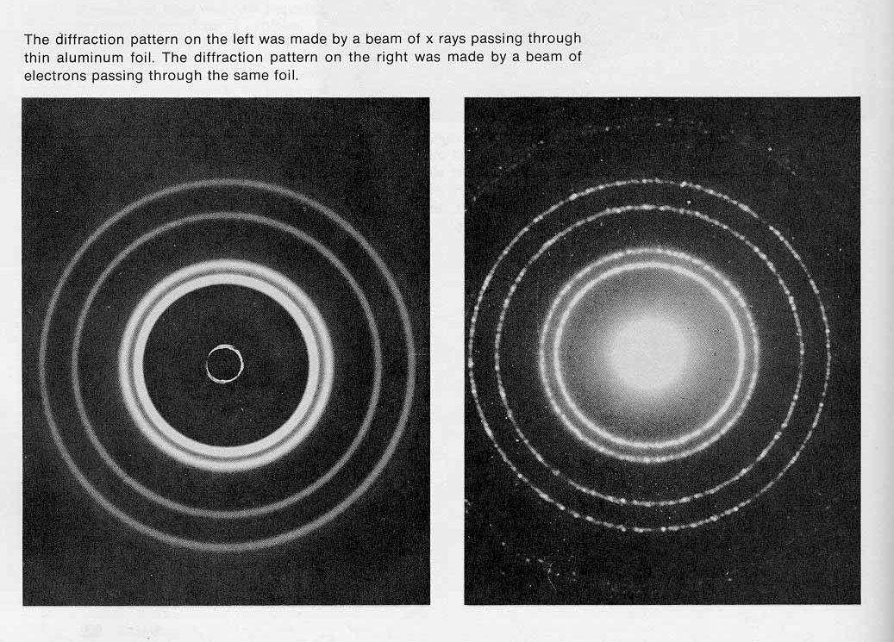
1. The Wave Property of Electrons
a. Electron diffraction experiment
(Davisson, Germer, Thomson, 1927)
A beam of either X rays (wave) or electrons (particle) is directed onto a target which is a gold foil
The scatter of X rays or electrons by the gold crystal produces a circular diffraction pattern on a photographic film
The pattern of the two experiments
are the same
Particle could act like a wave; both X rays and electrons are WAVE

Slide 8
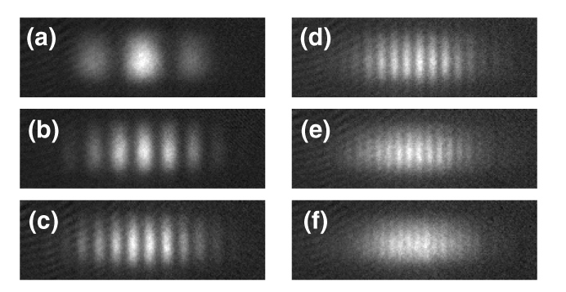
b. Discussion
• Similar diffraction and interference experiments have been
realized with protons, neutrons, and various atoms
(see “Atomic Interferometer”, Xuan Hoi DO, report of practice
of Bachelor degree of Physics, University Paris-North, 1993)
In 1994, it was demonstrated with iodine molecules I₂
Wave interference
patterns of atoms
• Small objects like electrons, protons, neutrons, atoms, and
molecules travel as waves - we call these waves “matter waves”

Slide 9

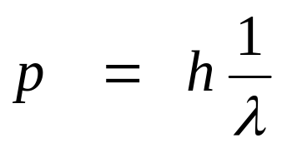
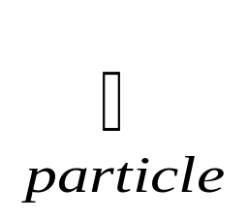
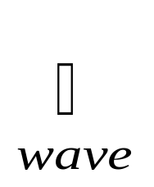
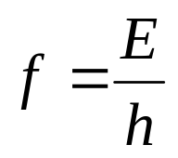
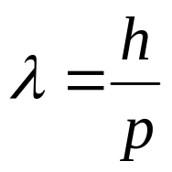
2. De Broglie’s Theory - Matter Wave
a. De Broglie’s relationships
We recall that
for a photon (E, p) associated to an electromagnetic wave (f, λ):
De Broglie’s hypothesis:
To a particle (E, p) is associated a matter wave,
which has a frequency f and a wavelength λ

Slide 10
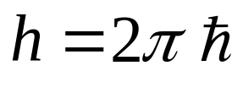
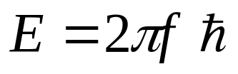
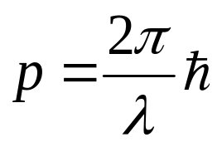


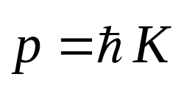
• From
and
if we put:
⇒
⇒
Planck-Einstein’s relationship
λ is called de Broglie wavelength

Slide 11
b. Conclusion. Necessity of a new science
• When we deal with a wave, there is always some quantity
that varies (the coordinate u, the electricity field E)
• For a matter wave, what is varying?
ANSWER:
That is the WAVE FUNCTION
→
New brand of physics:
THE QUANTUM MECHANICS

Slide 12
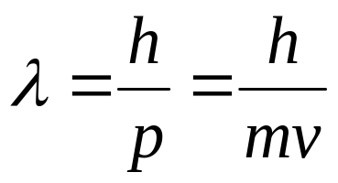
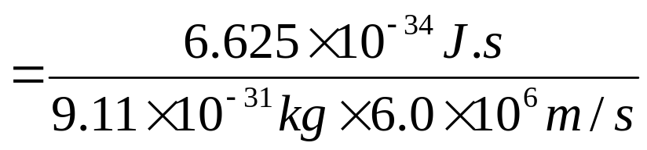

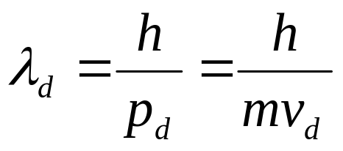
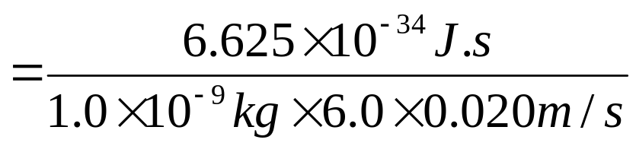
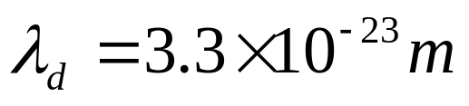
In a research laboratory, electrons are
accelerated to speed of 6.0 × 10⁶ m/s. Nearby, a 1.0 × 10⁻⁹ kg
speck of dust falls through the air at a speed of 0.020m/s.
Calculate the de Broglie wavelength in both case
PROBLEM 1
SOLUTION
• For the electron:
• For the dust speck:
DISCUSSION:
The de Broglie wavelength of the dust speck is so
small that we do not observe its wavelike behavior

Slide 13

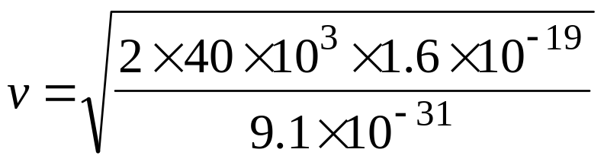

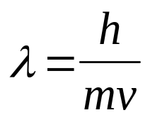
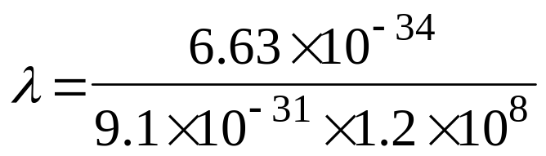
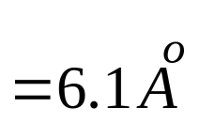

An electron microscope uses 40-keV electrons.
Find the wavelength of this electron.
PROBLEM 2
SOLUTION
The velocity of this electron:
The wavelength of this electron:

Slide 14


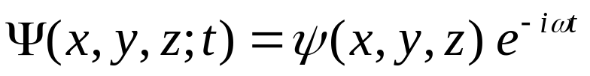
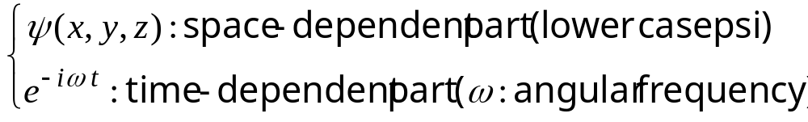
3. The Schrödinger’s Equation
a. Wave Function and Probability Density
Matter waves:
A moving particle (electron, photon) with momentum p is described
by a matter wave; its wavelength is
A matter wave is described by a wave function:
(called uppercase psi)
is a complex number
(a + ib with i² = -1, a, b: real numbers)
depends on the space (x, y, z) and on the time (t)
The space and the time can be grouped separately:

Slide 15

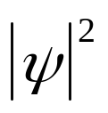
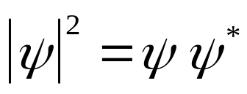




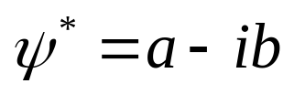
• The meaning of the wave function:
The function
has no meaning
Only
has a physical meaning.
That is:
The probability per unit time of detecting a particle in a small
volume centered on a given point in the matter wave is
proportional to the value at that point of
greater → it is easier to find the particle
N.B.:
with
is the complex conjugate of
If we write
(a, b: real numbers)
• How can we find the wave equation?
Like sound waves described by Newtonian mechanics,
or electromagnetic waves by Maxwell’s equation,
matter waves are described by an equation called
Schrödinger’s equation (1926)

Slide 16
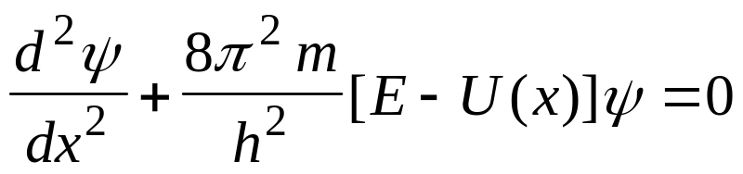
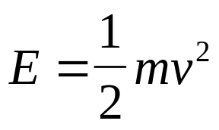

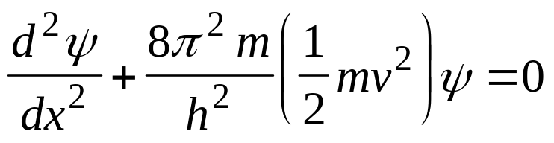
b. The Schrödinger’s equation
For the case of one-dimensional motion,
when a particle with the mass m has a potential energy U(x)
Schrödinger’s equation is
where E is total mechanical energy (potential energy plus kinetic energy)
Schrödinger’s equation is the basic principle
(we cannot derive it from more basic principles)
EXAMPLE:
Waves of a free particle
For a free particle, there is no net force acting on it, so
and
Schrödinger’s equation becomes:

Slide 17
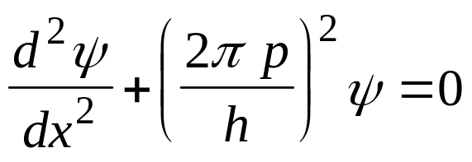

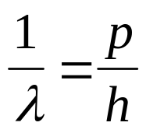
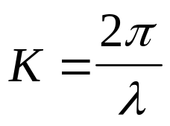
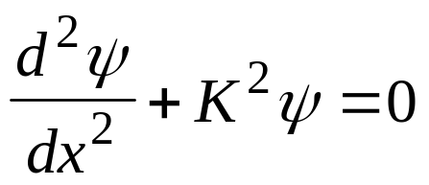
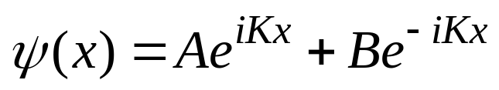
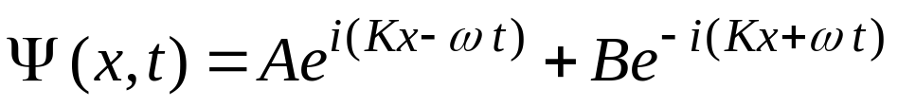
By replacing:
With the de Broglie wavelength:
and the wave number:
we have the Schrödinger’s equation for free particle:
This differential equation has the most general solution:
(A and B are arbitrary constants)
The time-dependent wave function:

Slide 18
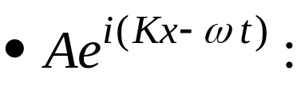
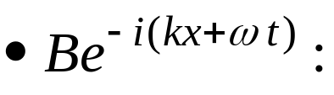

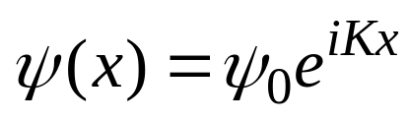
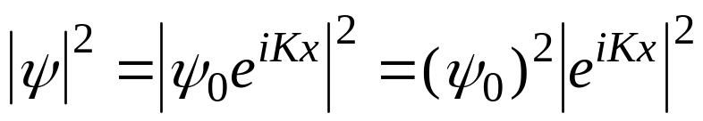
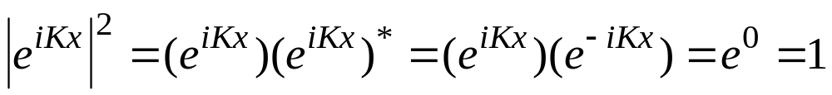
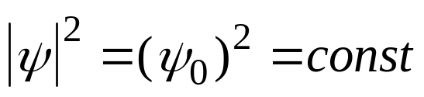
: traveling waves
wave traveling in the direction of increasing x
wave traveling in the negative direction of x
Probability density:
Assume that the free particle travels only in the positive direction
Relabel the constant A as
The probability density is:
Because:
we have:

Slide 19
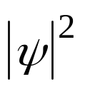
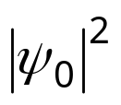
What is the meaning of a constant probability?
The plot of
is a straight line parallel to the x axis:
x
O
The probability density is the same for all values of x
The particle has equal probabilities of being anywhere
along the x axis: all positions are equally likely expected

Slide 20




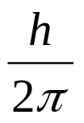

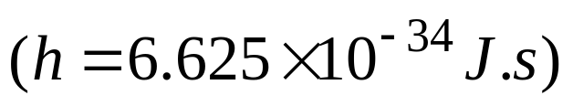
4. The Heisenberg’s uncertainty principle
• In the example of a free particle, we see that if its momentum is
completely specified, then its position is completely unspecified
• When the momentum p is completely specified we write:
(because:
and when the position x is completely unspecified we write:
• In general, we always have:
This constant is known as:
(called h-bar)
h is the Planck’s constant

Slide 21

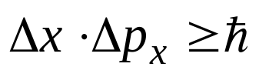
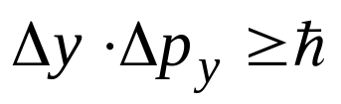
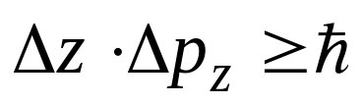




So we can write:
That is the Heisenberg’s uncertainty principle
“ it is impossible to know simultaneously and with exactness
both the position and the momentum of the fundamental particles”
N.B.: • We also have for the particle moving in three dimensions
• With the definition of the constant
• Uncertainty for energy :

Slide 22


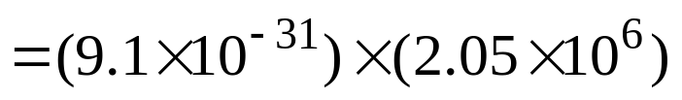
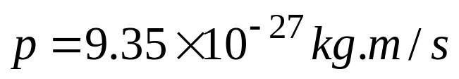






PROBLEM 3
An electron is moving along x axis with the speed of 2×106 m/s (known with a precision of 0.50%).
What is the minimum uncertainty with which we can simultaneously measure the position of the electron along the x axis? Given the mass of an electron 9.1×10-31 kg
SOLUTION
From the uncertainty principle:
if we want to have the minimum uncertainty:
We evaluate the momentum:
The uncertainty of the momentum is:

Slide 23



PROBLEM 4
In an experiment, an electron is determined to be within 0.1mm of a particular point. If we try to measure the electron’s velocity, what will be the minimum uncertainty?
SOLUTION
Observation:
We can predict the velocity of the electron to within 1.2m/s.
Locating the electron at one position affects our ability to know
where it will be at later times

Slide 24


PROBLEM 5
A grain of sand with the mass of 1.00 mg appears to be at rest on a smooth surface. We locate its position to within 0.01mm. What velocity limit is implied by our measurement of its position?
SOLUTION
Observation:
The uncertainty of velocity of the grain is so small that we do not
observe it: The grain of sand may still be considered at rest, as our
experience says it should

Slide 25


An electron is confined within a region of width 1.0×10⁻ ¹⁰ m. (a) Estimate the minimum uncertainty in the
x-component of the electron's momentum.
(b) If the electron has momentum with magnitude equal to the uncertainty found in part (a), what is its kinetic energy? Express the result in jou1es and in electron volts.
_x001f__x001d_
PROBLEM 6
SOLUTION
(a)
(b)

Slide 26


A sodium atom is in one of the states labeled ''Lowest excited levels". It remains in that state for an average
time of 1.6×10⁻⁸ s before it makes a transition back to a ground
state, emitting a photon with wavelength 589.0 nm and energy
2.105 eV. What is the uncertainty in energy of that excited state?
What is the wavelength spread of the corresponding spectrum line?
PROBLEM 7
SOLUTION
The fractional uncertainty of the photon energy is

Slide 27




5. Particle in a square well
• Consider a particle confined to a region 0 ≤ x ≤ a where it can
move freely, but subject to strong force at x = 0 and x = a
U
1. Solution of the Schrödinger’s equation
Schrödinger’s equation for the particle in the box:
0
a
x
Infinitely deep
potential energy well
By putting:

Slide 28







What values can take the constants A, B, and the condition for K ?
• With the boundary condition:
• Revision: We have the relations
and:

Slide 29






• With the boundary condition:
The momentum of the particle is:
The possible values of energy:

Slide 30




Bound states
Because n is an integer:
the energy can only have the discrete values:
3rd excited
E₄
We say that the energy is quantized
these values of energy are called energy levels
n = 1
ground state (E₁)
2nd excited
E₃
n = 2
first excited state (E₂)
n = 3
second excited state (E₃)
.
.
.
1st excited
E₂
E₁
ground
The integer n is called the quantum number
energy-level diagram

Slide 31





PROBLEM 8
An electron is confined to a one-dimensional, infinitely deep
potential energy well of width a = 100pm.
1/ What is the least energy (in eV) the electron can have?
2/ Compute the energy level of the first excited state, of the
second excited state. Draw the energy level diagram.
SOLUTION
1/ The least energy corresponds to the least quantum number:
n = 1 for the ground state. Thus:

Slide 32








2/ The energy level of the first excited state corresponds to n = 2:
The energy level of the second excited state corresponds to n = 3:
400
2nd excited
E₃
300
Energy (eV)
200
1st excited
E₂
100
Observation:
The levels are not equidistant
ground
E₁
0

Slide 33




PROBLEM 9
The wave function of a particle confined to an infinitely deep
potential energy well is
Determine the value of C, knowing that the particle must be
somewhere in all space
SOLUTION
If the probability density is
The probability of finding the particle in width dx is
The probability of finding the particle in all space is
Because we are sure to find the particle somewhere in all space, the
probability equals the unit:
Normalization condition:

Slide 34









For a particle confined to an infinitely deep potential energy well:
With:
Normalization condition:

Slide 35


PROBLEM 10
The wave function of a particle confined to an infinitely deep
potential energy well is
The depth of the well is a = 100 pm
What is the probability density of finding the particle at the distance
x = 50 pm for the value of the quantum number
1/ n = 1 ?
2/ n = 2 ?
SOLUTION
We have
The probability density is

Slide 36





SOLUTION
1/ For n = 1:
(x: pm)
0.02
x
0
50 pm
100 pm
2/ For n = 2:
(x: pm)
0.02
x
0
50 pm
100 pm

Slide 37

6. Tunneling Phenomena
a. The Square Barrier
The square barrier is represented by a potential energy U(x)
U
E
E₀
O
a
x
• For case of classical particles:
If a particle comes from the left with energy E < E₀ , it will be reflected back at x = 0.

Slide 38





b. Barrier penetration
U
E
Incident
E₀
Transmitted
Reflected
O
a
x
(I)
(II)
(III)
• In quantum mechanics:
The matter waves will have the solution for the region (I):
And the solution for the region (III):
A particle can go through the potential barrier even if its kinetic
energy is less than the height of the barrier: tunneling effect

Slide 39




U
E
Incident
Transmitted
E₀
Reflected
O
a
x
x
O
a
The wave function ψ_{I}: free incident particles
The wave function ψ_{II}: decays exponentially in the forbidden region
The wave function ψ_{III}: transmitted particles

